Slide 1
Data Analytics
Manoj K Jangra

Slide 2
What is Data Analytics?
Data analytics is the process of exploring and analyzing large datasets to find hidden patterns, unseen trends, discover correlations, and derive valuable insights to make smart business decisions.
So, a Data Analyst will extract raw data, organize it, and then analyze it, transforming it from incomprehensible numbers into coherent, intelligible information.
Having interpreted the data, the data analyst will then pass on their findings in the form of suggestions or recommendations about what the company’s next steps should be.

Slide 3
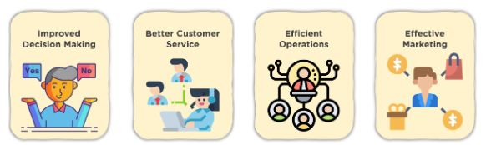
Ways to Use Data Analytics!!!

Slide 4
1. Improved Decision Making
Data Analytics eliminates guesswork and manual tasks.
Be it choosing the
right content,
planning marketing campaigns,
developing products.
Organizations can use the insights they gain from data analytics to make informed decisions. Thus, leading to better outcomes and customer satisfaction.

Slide 5
2. Better Customer Service
Data analytics allows you to:
Tailor customer service according to their needs
Provides personalization and builds stronger relationships with customers
Analyzed data can reveal information about customers’ interests, concerns, and more
It helps you give better recommendations for products and services.

Slide 6
3. Efficient Operations
With the help of data analytics:
You can streamline your processes,
Save money and boost production
With an improved understanding of what your audience wants, you spend lesser time creating ads and content that aren’t in line with your audience’s interests

Slide 7
4. Effective Marketing
Data analytics gives you valuable insights into:
How your campaigns are performing
This helps in fine-tuning them for optimal outcomes
Additionally, you can also find potential customers who are most likely to interact with a campaign and convert into leads

Slide 8
What is Data Analytics used for?
The truth is, data is absolutely everywhere—which means that data analytics has almost infinite uses across all kinds of businesses and organizations. Broadly speaking, data analytics is used to make faster and more informed decisions, to reduce overall business costs, to develop more effective products and services, and to optimize processes and operations. In more specific terms, data analytics might be used for the above mentioned tasks.

Slide 9
To predict future sales and purchasing behaviors
For security purposes—for example, to detect, predict, and prevent fraud within the insurance and banking industries
To evaluate the effectiveness of marketing and advertising campaigns
To optimize marketing efforts through more accurate targeting and personalization
To identify and eliminate bottlenecks within a certain process
To boost customer acquisition and retention
To boost customer engagement on social media
To develop risk management solutions
To identify opportunities for innovation and create new revenue streams
To increase supply chain efficiency

Slide 10
Data Analytics Vs Data Science!!!
You’ll find that the terms “data science” and “data analytics” tend to be used interchangeably. However, they are two different fields and denote two distinct career paths. What’s more, they each have a very different impact on the business or organization.
One key difference between data scientists and data analysts lies in what they do with the data and the outcomes they achieve.

Slide 11
Data Analyst!!!
A data analyst will seek to answer specific questions or address particular challenges that have already been identified and are known to the business.
To do this, they examine large datasets with the goal of identifying trends and patterns. They then “visualize” their findings in the form of charts, graphs, and dashboards. These visualizations are shared with key stakeholders and used to make informed, data-driven strategic decisions.

Slide 12
Data Scientist!!!
A data scientist, on the other hand, considers what questions the business should or could be asking.
They design new processes for data modeling, write algorithms, devise predictive models, and run custom analyses.
For example: They might build a machine to leverage a dataset and automate certain actions based on that data—and, with continuous monitoring and testing, and as new patterns and trends emerge, improve and optimize that machine wherever possible.
In short: data analysts tackle and solve discrete questions about data, often on request, revealing insights that can be acted upon by other stakeholders, while data scientists build systems to automate and optimize the overall functioning of the business.

Slide 13
Data Analyst!!!
Data analysts are typically expected to be proficient in software like Excel and, in some cases, querying and programming languages like SQL, R, SAS, and Python.
Analysts need to be comfortable using such tools and languages to carry out data mining, statistical analysis, database management and reporting.

Slide 14
Data Scientist!!!
Data scientists, on the other hand, might be expected to be proficient in Hadoop, Java, Python, Machine Learning, Data Mining, and Data Analysis.

Slide 15
What does a data analyst do?
“I like to think of a data analyst as a ‘translator’. It’s someone who is capable of translating numbers into plain English in order for a company to improve their business. Personally, my role as a data analyst involves collecting, processing, and performing statistical data analysis to help my company improve their product.”

Slide 16
Based on real job ads, here are some of the typical tasks and responsibilities of a data analyst:
Manage the delivery of user satisfaction surveys and report on results using data visualization software
Work with business line owners to develop requirements, define success metrics, manage and execute analytical projects, and evaluate results
Monitor practices, processes, and systems to identify opportunities for improvement
Proactively communicate and collaborate with stakeholders, business units, technical teams and support teams to define concepts and analyze needs and functional requirements
Translate important questions into concrete analytical tasks
Gather new data to answer client questions, collating and organizing data from multiple sources

Slide 17
Apply analytical techniques and tools to extract and present new insights to clients using reports and/or interactive dashboards
Relay complex concepts and data into visualizations
Collaborate with data scientists and other team members to find the best product solutions
Design, build, test and maintain backend code
Establish data processes, define data quality criteria, and implement data quality processes
Take ownership of the codebase, including suggestions for improvements and refactoring
Build data validation models and tools to ensure data being recorded is accurate
Work as part of a team to evaluate and analyze key data that will be used to shape future business strategies

Slide 18
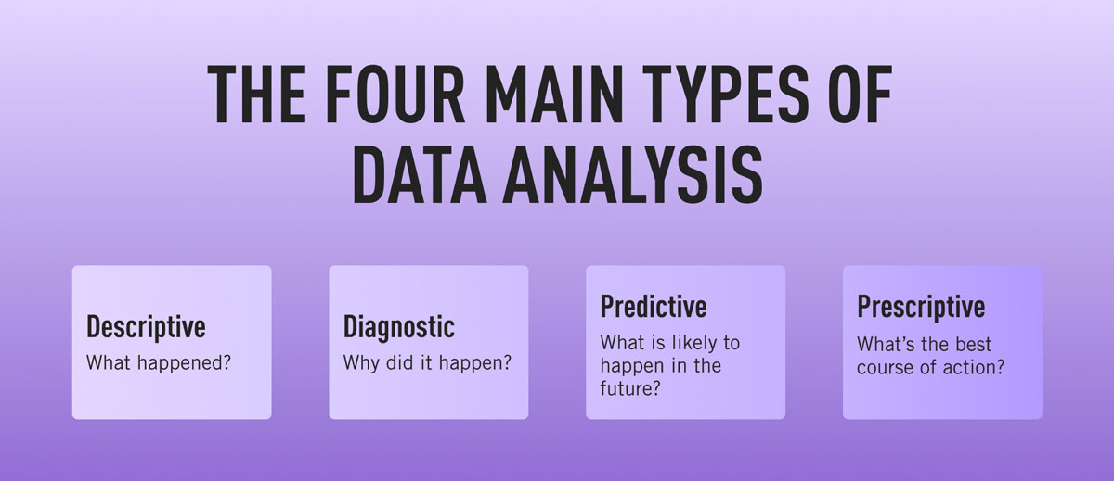
Types of Data Analysis!!!

Slide 19
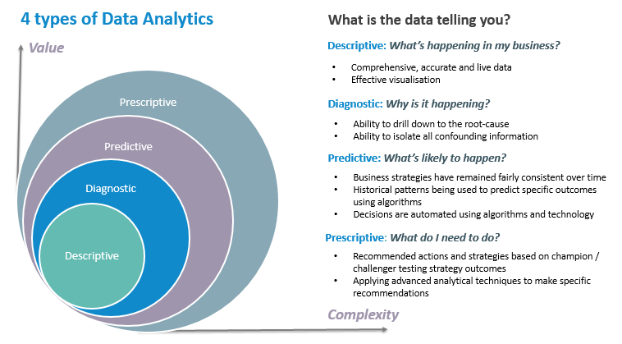

Slide 20

Descriptive
Analytics!!!

Slide 21
Descriptive Analytics!!!
Descriptive analytics is a simple, surface-level type of analysis that looks at what has happened in the past.
The two main techniques used in descriptive analytics are data aggregation and data mining—so, the data analyst first gathers the data and presents it in a summarized format (that’s the aggregation part) and then “mines” the data to discover patterns.
The data is then presented in a way that can be easily understood by a wide audience (not just data experts).
It’s important to note that descriptive analytics doesn’t try to explain the historical data or establish cause-and-effect relationships; at this stage, it’s simply a case of determining and describing the “what”. Descriptive analytics draws on descriptive statistics, which you can learn about here.

Slide 22

Diagnostic
Analytics!!!

Slide 23
Diagnostic Analytics!!!
While descriptive analytics looks at the “what”, diagnostic analytics explores the “why”.
When running diagnostic analytics, data analysts will first seek to identify anomalies within the data—that is, anything that cannot be explained by the data in front of them.
For example: If the data shows that there was a sudden drop in sales for the month of March, the data analyst will need to investigate the cause.
To do this, they’ll embark on what’s known as the discovery phase, identifying any additional data sources that might tell them more about why such anomalies arose.
Finally, the data analyst will try to uncover causal relationships—for example, looking at any events that may correlate or correspond with the decrease in sales. At this stage, data analysts may use probability theory, regression analysis, filtering, and time-series data analytics.

Slide 24

Predictive
Analytics!!!

Slide 25
Predictive Analytics!!!
Just as the name suggests, predictive analytics tries to predict what is likely to happen in the future.
This is where data analysts start to come up with actionable, data-driven insights that the company can use to inform their next steps.
Predictive analytics estimates the likelihood of a future outcome based on historical data and probability theory, and while it can never be completely accurate, it does eliminate much of the guesswork from key business decisions.
Predictive analytics can be used to forecast all sorts of outcomes—from what products will be most popular at a certain time, to how much the company revenue is likely to increase or decrease in a given period. Ultimately, predictive analytics is used to increase the business’s chances of “hitting the mark” and taking the most appropriate action.

Slide 26

Prescriptive
Analytics!!!

Slide 27
Prescriptive Analytics!!!
Building on predictive analytics, prescriptive analytics advises on the actions and decisions that should be taken.
In other words, prescriptive analytics shows you how you can take advantage of the outcomes that have been predicted.
When conducting prescriptive analysis, data analysts will consider a range of possible scenarios and assess the different actions the company might take.
Prescriptive analytics is one of the more complex types of analysis, and may involve working with algorithms, machine learning, and computational modeling procedures. However, the effective use of prescriptive analytics can have a huge impact on the company’s decision-making process and, ultimately, on the bottom line.

Slide 28
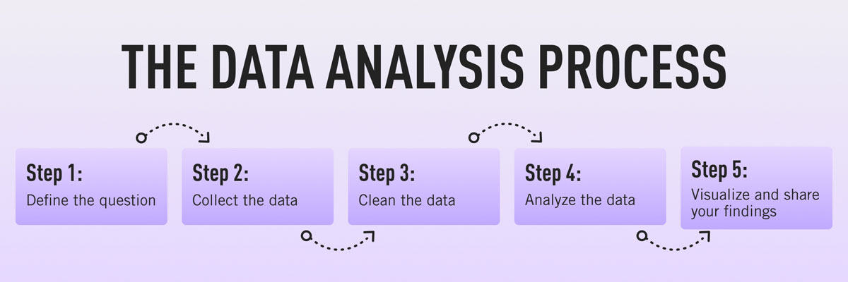
Data Analytics Life Cycle!!!

Slide 29
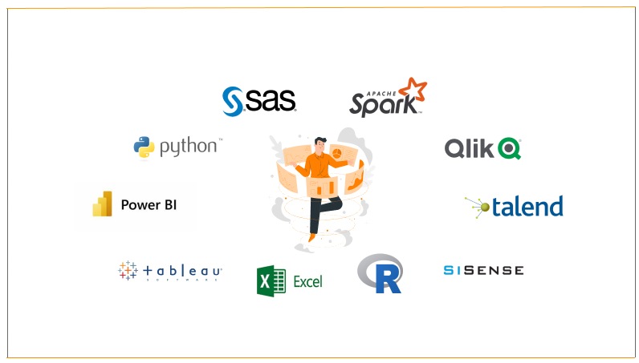
Data Analytics Tools!!!

Slide 30
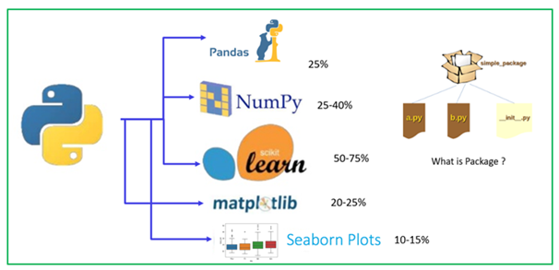
Python Data Analytics Libraries!!!

Slide 31
Thank You!!!

